Slide 1
Subject Name: Computer Architecture
Paper Code: CSEN 2203

Slide 2
B.Tech 2nd Year 4th Semester SecA |  |  |  |  |  |  |  |  |  | Session 2016-2017
 |  | 9:00-9:55 | 9:55-10:50 | 10:50-11:45 | Break |  | 12:25:13:20 | 13:20-14:15 | 14:15-15:10 | 15:10-16:05 | 16:05-17:00 | 17:00-17:55
Mon | Gr-1 | L /MATH2202 /JC /ICT304 | L /CSEN2203 /AG /ICT304 |  | L /HMTS2002 /NG, AL /CB514 (A+B) |  |  | L /MATH2201 /SD /ICT304 | LAB /CSEN2213 /AG/ SHS+AS /ICT B10
 | Gr-2 |  |  |  |  |  |  |  | T2 /PHYS2001 /AC /ICT305 | LAB /MATH2212 /SD, SCK /ICT B11
Tue | Gr-1 | L /CSEN2201 /PBC /ICT304 | T1 /CSEN2201 /PBC /ICT304 | L /CSEN2203 /AG /ICT304 |  |  | L /MATH2201 /SD /ICT304 | L /PHYS2001 /AD /ICT304 | T1 /PHYS2001 /HG /ICT304 | LAB /HMTS2011 /ARD /CME005
 | Gr-2 |  |  |  |  |  |  |  | LAB /CSEN2213 /AG/DS+ABS /ICT B11
Wed | Gr-1 | L /PHYS2001 /SS /ICT304 | L /MATH2201 /SC /ICT304 |  |  |  | L /MATH2202 /JC /ICT304
 | Gr-2
Thu | Gr-1 | L /CSEN2203 /AG /ICT304 | L /CSEN2201 /SM /ICT304 |  |  |  | LAB /MATH2212 /SD, SCK /ICT B11 |  | Remedial
 | Gr-2 |  |  |  |  |  | LAB /PHYS2011 /AD/CB108 |  |  | LAB /HMTS2011 /ARD /A203
Fri | Gr-1 | LAB /PHYS2011 /AC /CB108 |  |  |  |  | T1 /CSEN2203 /AG /ICT304 | L /PHYS2001 /DM /ICT304 | L /MATH2202 /AMB /ICT304
 | Gr-2 | T2 /CSEN2201 /SM /ICT305 | T2 /CSEN2203 /AG /ICT304 |  |  |  | Remedial
 |  | The even semester routine for the Session 2016-2017 will be effective from 16th January 2017

Slide 3
Books
1) Kai Hwang: Advanced Computer Architecture – Parallelism, etc.
2) Hennessey & Patterson : Computer Architecture – A Quantitative Approach
3) Hamacher et el: Computer Organization (5th Ed) & above
4) Kai Hwang & Briggs: Computer Architecture & Parallel Processing

Slide 4
Syllabus
Module 1: Introduction:
Review of basic computer architecture;
Pipelining: Basic concepts,
Instruction and arithmetic pipeline,
Scheduling in Pipeline;
Data hazards, control hazards and structural hazards, techniques for handling hazards.
Module 2:Instruction-level parallelism: Basic concepts,
Array and vector processors.
Superscalar, Superpipelined and VLIW processor architectures.
Interconnection networks:
Crossbar, Delta, Omega, Shuffle-Exchange, Banyan , Hypercube, Butterfly Networks.

Slide 5
Syllabus
Module 3:Measuring and reporting performance:
CPI,MIPS etc. Amdahl’s Law & Gustafson’s Law.
Hierarchical memory technology:
Inclusion, Coherence and locality properties;
Cache memory organizations, Techniques for reducing cache misses;
Virtual memory organization, mapping and management techniques, memory replacement policies.
Multiprocessor architecture: (6L)
Taxonomy of parallel architectures;
Centralized shared- memory architecture;
Distributed shared-memory architecture.
Cluster computers

Slide 6
Syllabus
Module 4:
Issues with Multiprocessor Architectures:
Synchronization, memory consistency; Cache Coherence protocols (brief discussion only);
Non von Neumann architectures:
Data flow computers, RISC architectures, Systolic architectures.

Slide 7
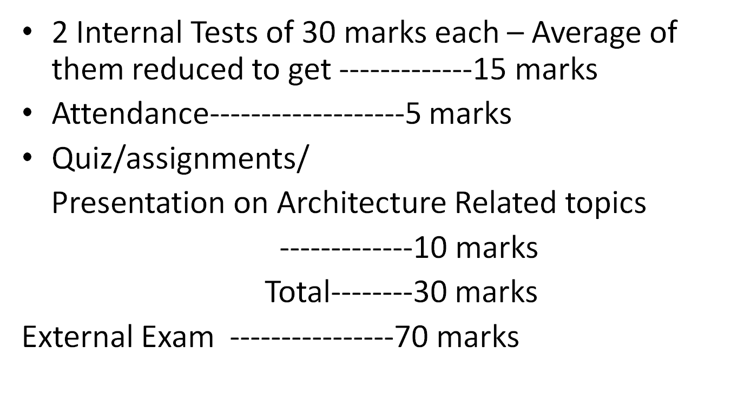
Assessment

